Slide 1
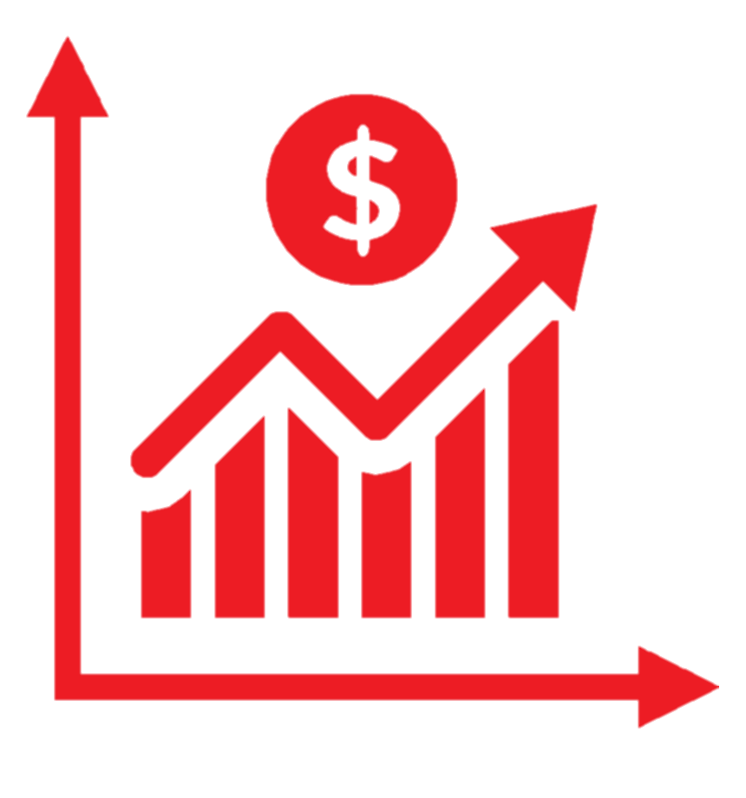
SmartStock
SmartStock is an investment application which allows users to search for any equity, currency, cryptocurrency, index etc. between a select date range and plot various technical indicators. It also has the ability for a user to train and test 6 different machine learning models and retrieve the predicted closing price for tomorrow.
Created by Ronan Hayes

Slide 2
Goals
The first goal of this project is to develop accurate and successful machine learning models which can predict tomorrows closing price relatively well.
I will then implement these models into a user friendly web application created using the Dash framework. It will be fully interactive and allow for various user input. Along with the models it will allow you to plot various technical indicators.
My personal goals include developing my skills within Python and using new libraries. Another being my understanding of machine learning and specific algorithms. Lastly, I can learn a new, modern framework for developing interactive data visualization web applications using Dash.

Slide 3
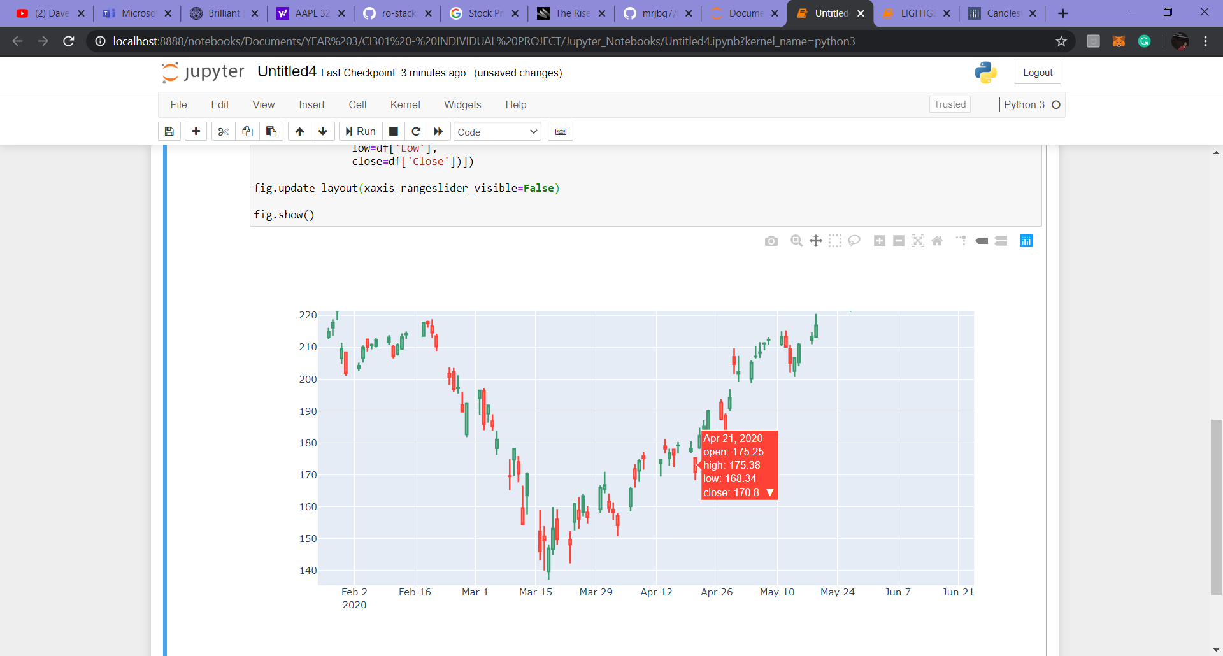
Data
Using Pandas Datareader I can access the complete historical data for any given symbol such as equities like Facebook, Index’s like FTSE100 or foreign exchange currency pairs such as Great British Pound to United States Dollar. It retrieves the Open, High, Low, Close and Adjusted Close prices as well as the Volume daily.

Slide 4
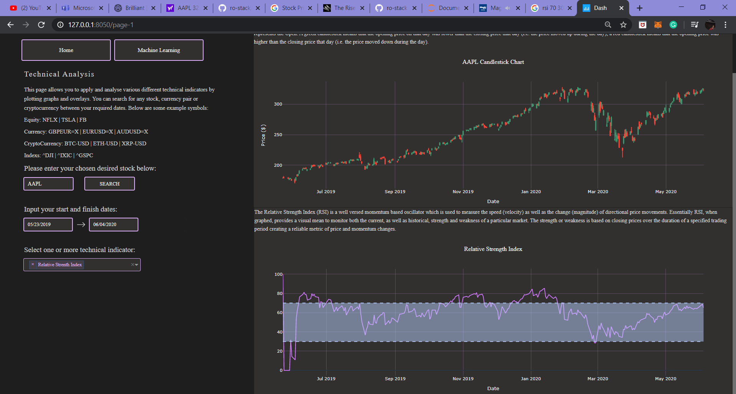
Technical Indicators
Technical Indicators are mathematical calculations based on historical data that are used to identify trading opportunities and decisions.
I will be adding a number of these as features within my models using the library TA-Lib which has over 150 indicators. I will focus on overlay studies and momentum.
The graph below represents the Relative Strength Index indicator., this measures the speed and change of price movements. When the line is above 70 it’s considered overbought, and when it’s below 30 it’s considered oversold.

Slide 5
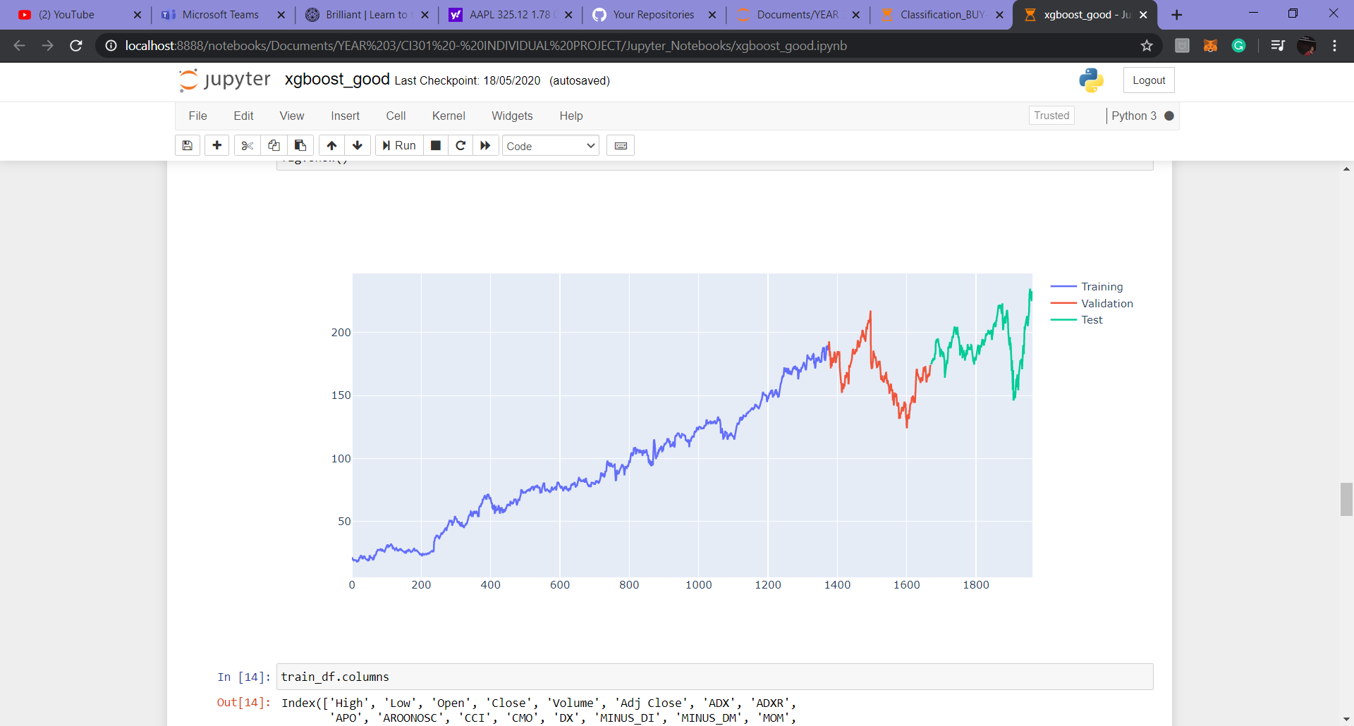
Machine Learning
I developed 6 regression models for predicting the next days closing price.
These include: XGBoost, LightGBM, SVR, Random Forest, Decision Tree and Linear Regression.
I normalized my data which I found to improve my results.
I also used Grid Search for each model to optimize the parameters before finalizing the model.

Slide 6

Dash by Plotly
Dash by Plotly is a modern Python framework for building web applications, specifically data visualization.
It is written on top of Flask, Plotly.js and React.js.
It allows for highly customisable user interfaces.
It is very productive and makes developing an interactive analytical app much easier.
Dash is lightweight as there is no JavaScript and you only need to use Python and HTML, as well as CSS if you are styling yourself.
There are external stylesheets available but I wanted to customize the app to my liking so CSS was used to customize every element of the application.
The use of interactive UI controls like dropdowns, date ranges and inputs allow us to make the app more hands on and analyse the data further.
Plotly graphs are extremely good too as they are dynamic and allow for many different functions.

Slide 7
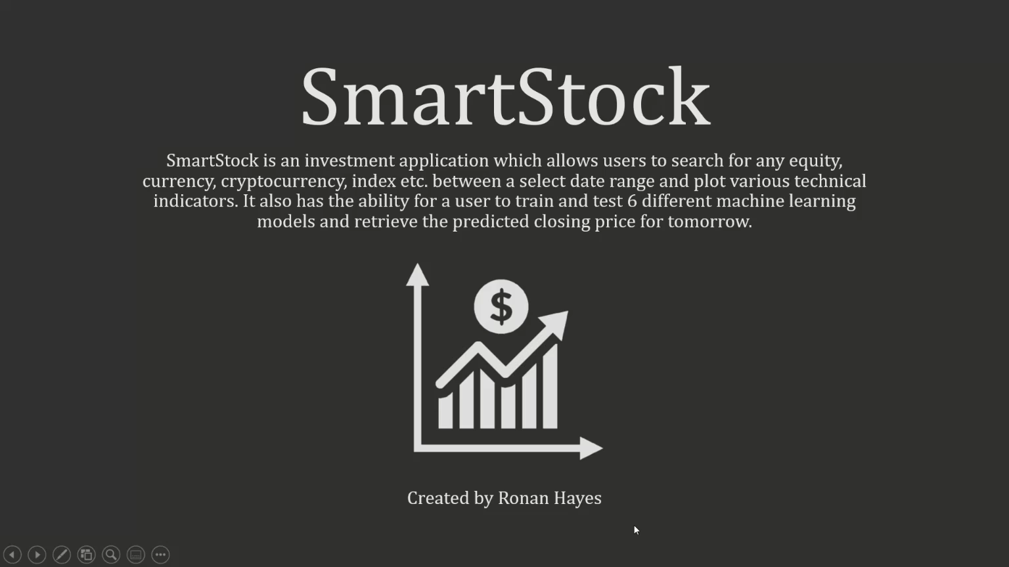
Demonstration

Slide 8
Future Developments
I would have liked to figure out why the data table caused the entire CSS to be affected and then include the news page. This could then be further enhanced to include the sentiment for that days news and plot a pie chart.
Within my models I include evaluation metrics, these could be implemented into the machine learning page and updated once a model has run to give the user better insight into the model rather than just the graph.
I would like to further enhance my models and try and make them even more reliable and successful, as well as maybe adding new ones. A page which demonstrates my classification models could be included too.
Lastly, I would like to deploy it to a server such as Heroku this way it can be used by anyone with the URL, rather than it only being able to be used once run locally. This would be good for employers.

